Slide 1
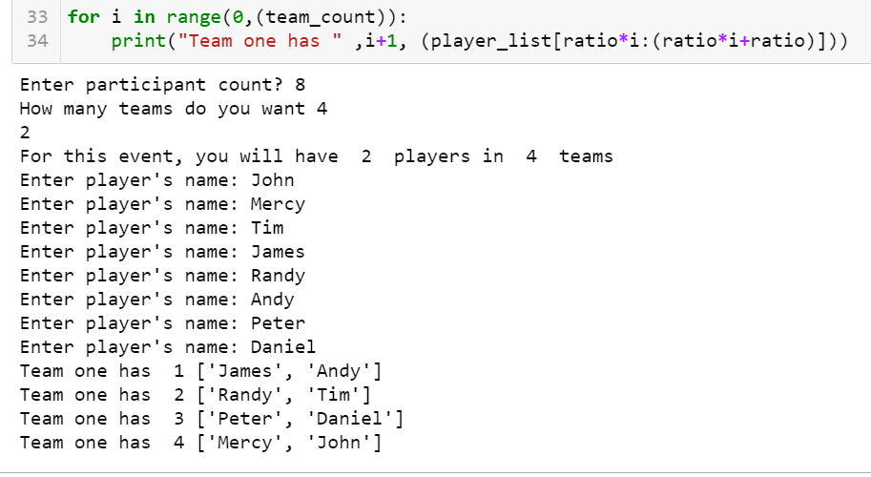

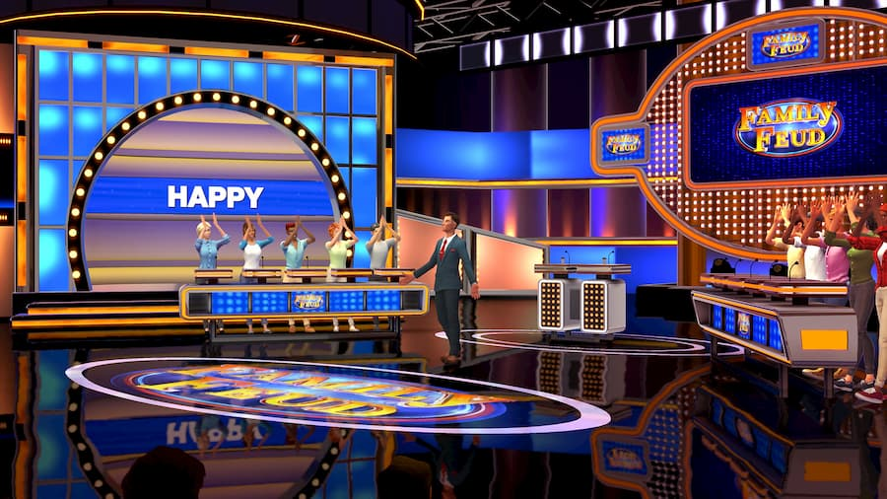
Fair Team Creator
By
John Ekpoudom & Mercy Otu
Have you attended a family or friends gathering and you all decide to play game.
Before you realize everyone have already picked their favorite or people they think can win the one without making it FAIR??
INTRODUCING….
FAIR TEAM CREATOR!!!
Our main priority is making sure everything is fair..
As the name implies, Fair Team Creator helps you pick teams fairly. Say Goodbye to losing family games because the teams were not picked fairly and Welcome to the world were teams are picked fairly and quickly without any stress!!

